Slide 1



Team “Japhette Orchid”
Javascript Basics Team Project
By:
Христо Петров
Ивелин Кирилов
Асен Жечев
Димитър Стоянов

Slide 2
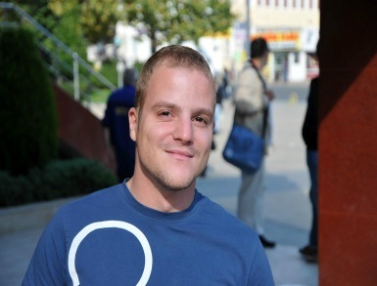


Team members
Христо Петров
Game Logic
Collision Detection
Ивелин Кирилов
Level Generation
AJAX File Reader
Асен Жечев
Game Design
Graphics
Димитър Стоянов
Game Logic
Collision Detection
Main Repository: https://github.com/Razhagal/Team-Japhette-Orchid

Slide 3
Project task
Design and implement a client-side JavaScript game
Team “Japhette Orchid” project name:
“Alphabounce”
http://hpetrovit.com/webproject/alphabounce/

Slide 4
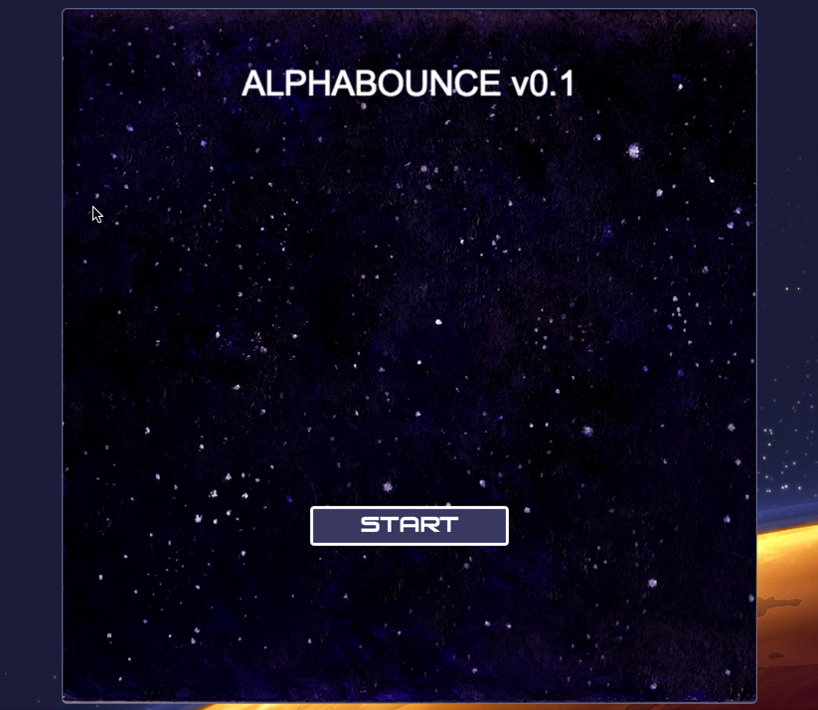
Game preview

Slide 5
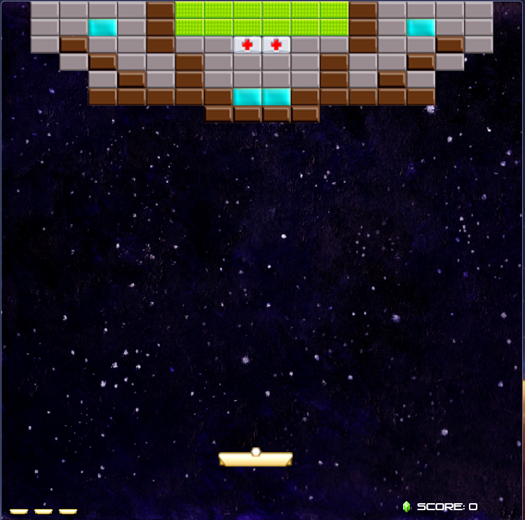
result
Simple to play.
Addictive gameplay.
Lots of PowerUps and bonuses.
Nice graphics.

Slide 6
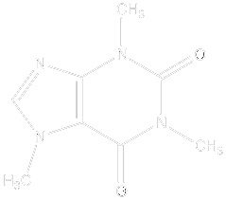



Tools and resources
Languages: HTML5, CSS, JavaScript
IDEs: Visual Studio, WebStorm, SublimeText
Version control tool: GitHub
Saviors: Google, Red Bull, Caffeine

Slide 7
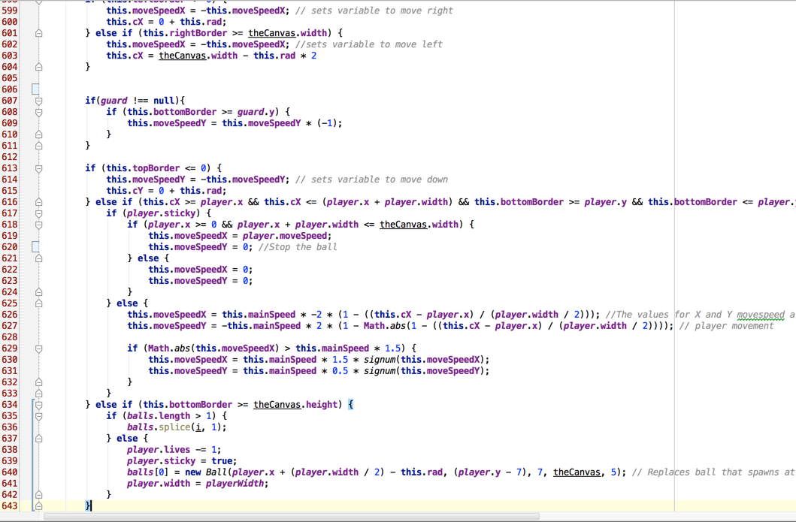
Source preview

Slide 8
Thank you for your attention.

